Slide 1
XAML Data Binding Developer’s Guide to Windows 10
Andy Wigley Shen Chauhan
@andy_Wigley @shenchauhan

Slide 2
Agenda
Data binding basics
Compiled binding

Slide 3
Data binding basics

Slide 4
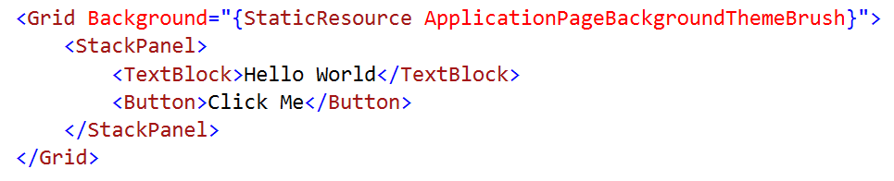
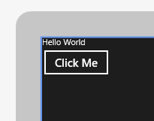
Literal Data
You could hard code everything, but…
Not very dynamic.

Slide 5
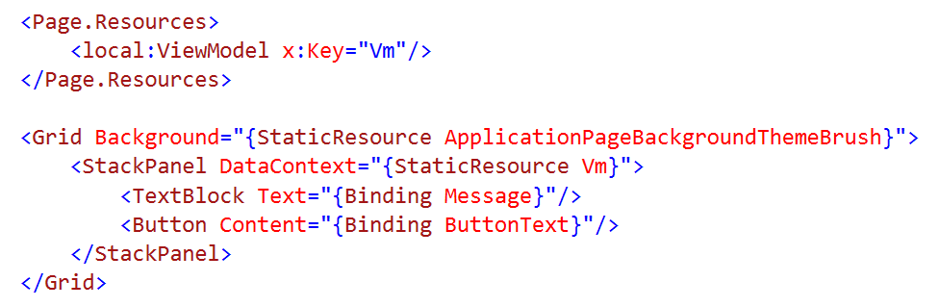
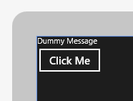
Dynamic Data
Use data binding to connect to a data source
Typical data source would be a view model

Slide 6
Updating the UI
INotifyPropertyChanged
Implement in a view model class
Raised by View Model when property value changes
INotifyCollectionChanged
Implemented in ObservableCollection<T> and ReadOnlyObservableCollection<T>
Raised by the collection when the collection is modified
(also IObservableVector)

Slide 7
New for dependency properties register for property changes

Slide 8
Syntax
<TextBox Text="{Binding
Converter
ConverterLanguage
ConverterParameter
ElementName
FallbackValue
Mode
Path
RelativeSource
Source
TargetNullValue
UpdateSourceTrigger}

Slide 9
Converting Data
Converters change data during binding
Raw datatype > Converter > Formatted string
IValueConverter
Convert method
Converts data to a new format/value before assignment
ConvertBack method
Converts data from the new format/value updating source
Often not implemented

Slide 10
Demo: Classic binding

Slide 11
Data bind to models or data bind to elements

Slide 12
Demo: ElementName

Slide 13
Compiled binding

Slide 14
Introducing compiled binding
Premise:
How do we keep the power of {Binding} but make it faster?
New mechanism for data binding in Xaml Apps
Heavy lifting is done at project build time rather than at runtime
Declarative bindings are converted into generated code behind
Eliminates need for slow runtime “reflection” operations
Code can be inspected and debugged
x:Bind bindings are validated at build time

Slide 15
What problem are we solving?

Slide 16
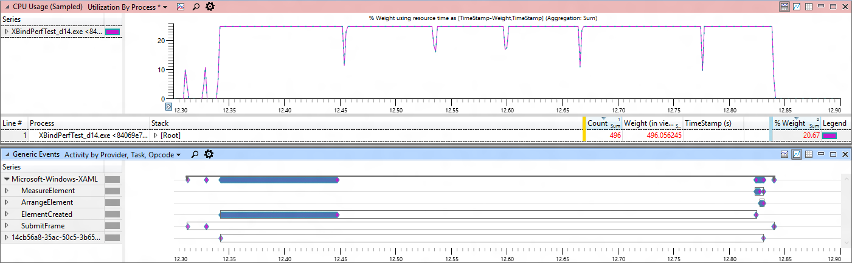
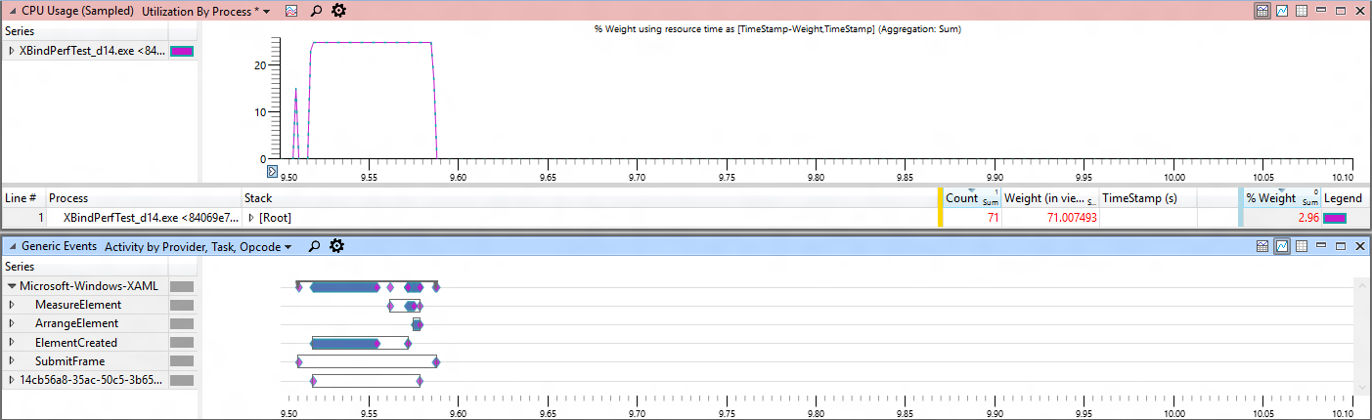
Classic Binding
Compiled Binding

Slide 17
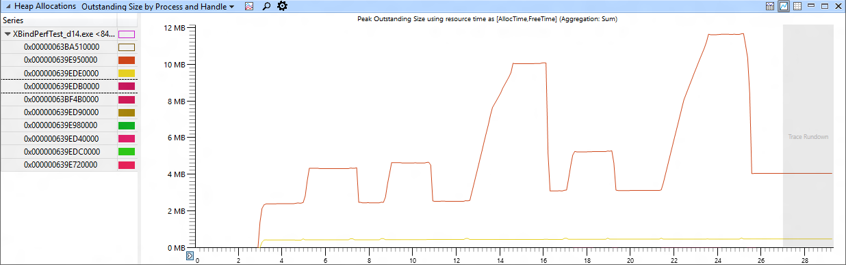
Memory Comparison
x:Bind
OneWay
No
Bindings
x:Bind
OneTime
{Binding}
OneWay
{Binding}
OneTime
1600 borders with their background databound

Slide 18
x:Bind
Compiled binding
Bindings are committed at compile-time
Strongly-typed binding
Duck binding is not supported
Default mode is OneTime
OneWay and TwoWay are still available
Standard binding approaches
INotifyPropertyChanged, IObservableVector, INotifyCollectionChanged

Slide 19
The data context of x:Bind is the code-behind class

Slide 20
Syntax
<TextBox Text="{x:Bind
Converter
ConverterLanguage
ConverterParameter
ElementName
FallbackValue
Mode
Path
RelativeSource
Source
TargetNullValue
UpdateSourceTrigger}
<TextBox Text="{Binding
Converter
ConverterLanguage
ConverterParameter
ElementName
FallbackValue
Mode
Path
RelativeSource
Source
TargetNullValue
UpdateSourceTrigger}

Slide 21
Data Templates
<ListView ItemsSource="{x:Bind ViewModel.Employees}">
<ListView.ItemTemplate>
<DataTemplate x:DataType="model:Employee">
<Grid>
<TextBlock Text="{x:Bind Name}"/>
</Grid>
</DataTemplate>
</ListView.ItemTemplate>
</ListView>

Slide 22
Demo: Compiled binding

Slide 23
Syntax differences
<ListView ItemsSource="{Binding Items}" Header="Classic" Grid.Column="0">
<ListView.ItemTemplate>
<DataTemplate>
<TextBlock Text="{Binding Title}" />
</DataTemplate>
</ListView.ItemTemplate>
</ListView>
<ListView ItemsSource="{x:Bind ViewModel.Items}" xmlns:m="using:Blank3.Models"
Header="Compiled" Grid.Column="1">
<ListView.ItemTemplate>
<DataTemplate x:DataType="m:TodoItem">
<TextBlock Text="{x:Bind Title}" />
</DataTemplate>
</ListView.ItemTemplate>
</ListView>

Slide 24
Improve performance by simplifying your templates

Slide 25
Resource dictionaries
<ResourceDictionary
x:Class="MyNamespace.MyTemplates"
xmlns:model="using:xBindSampleModel">
<DataTemplate
x:Key="MyTemplate"
x:DataType="model:Employee">
<TextBlock Text="{x:Bind Name}" />
</DataTemplate>
</ResourceDictionary>
namespace MyNamespace
{
public class MyTemplates
{
public MyTemplates()
{
InitializeComponent();
}
}
}

Slide 26
Referencing a dictionary
</UserControl.Resources>
<ResourceDictionary>
<ResourceDictionary.MergedDictionaries>
<local:MyTemplates/>
<ResourceDictionary Source="filename" />
</ResourceDictionary.MergedDictionaries>
</ResourceDictionary>
</UserControl.Resources>

Slide 27
Use Bindings.Update() for async data (incl. OneTime)

Slide 28
Binding for Events
<Button Click="PokeEmployee">Poke Employee</Button>
<Button Click="{x:Bind Employee.Poke}">Poke Employee</Button>
Signature
Have no parameters - void Poke()
Match event parameters - void Poke(object sender, RoutedEventArgs e)
Match event base types - void Poke(object sender, object e)
Overloading is not supported
Because all events are eligible:
This may replace ICommand & EventToCommand
Note: this does not include parameter or CanExecute

Slide 29
Bindings.StopTracking() pauses compiled bindings

Slide 30
How do I?
RelativeSource = Self & ElementName
Reference elements by name in Text="{x:Bind MyElement.Text}"
RelativeSource = TemplatedParent
Cannot use x:Bind in control templates; TemplateBinding is already optimized
Source / DataContext
Add a ViewModel to your code-behind

Slide 31
Page.ViewModel
public sealed partial class MainPage : Page
{
public MainPage()
{
InitializeComponent();
this.DataContextChanged += (s, e) =>
{
ViewModel = DataContext as ViewModels.MainPageViewModel;
};
}
// strongly-typed view models enable x:bind
public ViewModels.MainPageViewModel ViewModel { get; set; }
}

Slide 32
{x:Bind} is not for every situation (yet)

Slide 33
When to use classic binding
Duck Typing
Text=“{Binding Age}” works for both PersonModel & WineModel
Dictionary graphs
Use {Binding} with JSON or other untyped objects
Code-behind binding
Can add/remove {x:Bind} @ runtime
Use in a style
{x:Bind} can’t be used in a style for setters
{x:Bind} can be used in a DataTemplate that is defined in the style

Slide 34
x:Bind can meet your binding needs most of the time.

Slide 35
Review
Data binding basics
Compiled binding

